Slide 1



Fundamentals of marketing
Unit-6
Product Decisions
Contents
Concept and levels of product
Product classifications and market considerations
Product life cycle stages and strategies
New product development process
Branding strategies
Branding objectives
Types of brand
Concept of brand equity
Packaging
Functions and levels of packaging
Essentials of a good package
Product line and mix strategies
Service product strategies
Service marketing concept
Characteristics of services and marketing strategies
Management of people, physical evidences and process
2/5/2019 10:03 PM

Slide 2
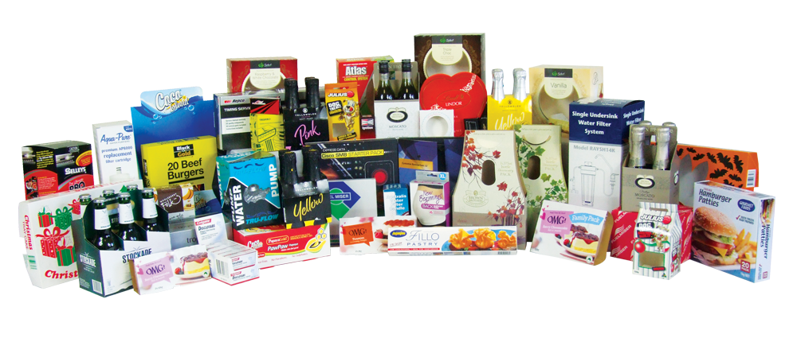
Product
A product is the core element of marketing mix which satisfies a need or want of customers.
According to Philip Kotler:
“A product is anything that can be offered to a market to satisfy a want or need.”
“A product is anything, tangible or intangible, which can be offered to a market for attention, acquisition, use or consumption that might satisfy a need or want.”
According to Peter Drucker:
“So long as a product is not bought and consumed, it remain a raw material.”
According to Willian J. Stanton:
“A product is a set of tangible and intangible attributes, including packaging, colour, price, quality and brand, plus the seller’s services and reputation.”
2/5/2019 10:03 PM

Slide 3
Product
Product is the main source of revenue for the business firm. It is the anything that satisfies the customer needs and wants.
A product can be:
Goods
Services
Experiences
Events
Persons
Places
Properties
Organizations
Ideas
Information
Features
Quality
Design
Warranties
Services
Variety
Packaging
Branding
2/5/2019 10:03 PM

Slide 4
Concept of Product
Tangible Concept
Intangible Concept
Augmented Concept
Total Product Concept
2/5/2019 10:03 PM

Slide 5
Concept of Product
Tangible Concept
It is the traditional concept which views a product as a physical object that can be seen or touched and felt by the sensory organs.
It can be owned.
It have basic attributes such as a name, shape, design, color, flavor, taste and quality.
Cars
Motorcycles
Books
Table
Chairs
Instant noodles etc.
Intangible Concept
Augmented Concept
Total Product Concept
2/5/2019 10:03 PM

Slide 6
Concept of Product
Tangible Concept
This concept views that every product has utilities and benefits attached with the physical objects.
The product cannot be seen or touched.
It cannot be owned.
They can be felt by the consumer.
Service
Ideas
Experience
Events etc.
Intangible Concept
Augmented Concept
Total Product Concept
2/5/2019 10:03 PM

Slide 7
Concept of Product
Tangible Concept
This concept is the combination of both tangible and intangible products where the physical goods are accompanied by services packages.
Customer may be offered more than what he/she thinks, needs or expects.
Computer that comes with “Office 2013” already installed.
Offer two year warranty for semiconductor process equipment where the norm is one year.
Solar heater with free installation service and photocopy machine with two years warranty for free repair and maintenance.
Intangible Concept
Augmented Concept
Total Product Concept
2/5/2019 10:03 PM

Slide 8
Concept of Product
Tangible Concept
This concept views a product as the total offer to the buyers.
It combines tangible, intangible and augmented product concepts where it focuses on features, advantages and benefits of a product.
Features: Physical characteristics
Advantages: Product performance
Benefits: Results of buying
Physical goods are accompanied by service packages.
Offering a car, the marketing firm can include the brand, design, price, performance, comfort, mileage, servicing, warranty, credit and many other aspects.
Intangible Concept
Augmented Concept
Total Product Concept
2/5/2019 10:03 PM

Slide 9
Level of Product
Core
Product
Basic/Actual Product
Expected Product
Augmented Product
Potential Product
2/5/2019 10:03 PM

Slide 10
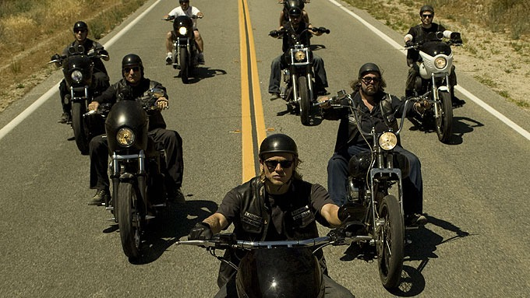

Level of Product
There is core benefit and the essential utility attached with a product.
It is the services or benefit customers buy.
Buyers purchase a product for the benefits and satisfaction attached with the product.
E.g.
A purchaser of a drill is buying holes.
Woman buys beauty for herself through cosmetics.
Boys buys status and prestige through modern sporty bikes.
A hotel guest is buying rest and sleep.
Core
Product
2/5/2019 10:03 PM

Slide 11

Level of Product
It is design, quality, features, brand and packaging offered to customers.
Marketers convert the core benefits into a basic product.
E.g.
A hotel room includes a bed, bathroom, towels, desk, dresser and closet.
Some chemicals are combined to manufacture face creams, shampoo and other cosmetics items that provide beauty and personality to the users.
Actual/Basic
Product
2/5/2019 10:03 PM

Slide 12

Level of Product
A set of attributes and conditions buyer normally expect in a product.
Expected products are built over the core benefits and basic product.
It has up to five attributes: A quality level, Features, Design, Brand name & Packaging.
E.g.
Hotel guests minimally expect a clean bed, fresh towels, working lamps and a relative degree of quite.
Expected
Product
2/5/2019 10:03 PM

Slide 13

Level of Product
It is added benefits and services that satisfy customers beyond their expectations.
It is the totality of benefits a buyer receives or experiences in obtaining the product.
A person buying a product is not merely buying the physical object or benefits but the whole range of services attached with the product.
In developed countries, brand positioning and competition take place at this level. In developing and emerging markets such as India and Brazil, however, competition takes place mostly at the expected product level.
E.g.
Free helmets with motorbikes.
Installation, delivery, services, credit and warranty.
Augmented
Product
2/5/2019 10:03 PM

Slide 14
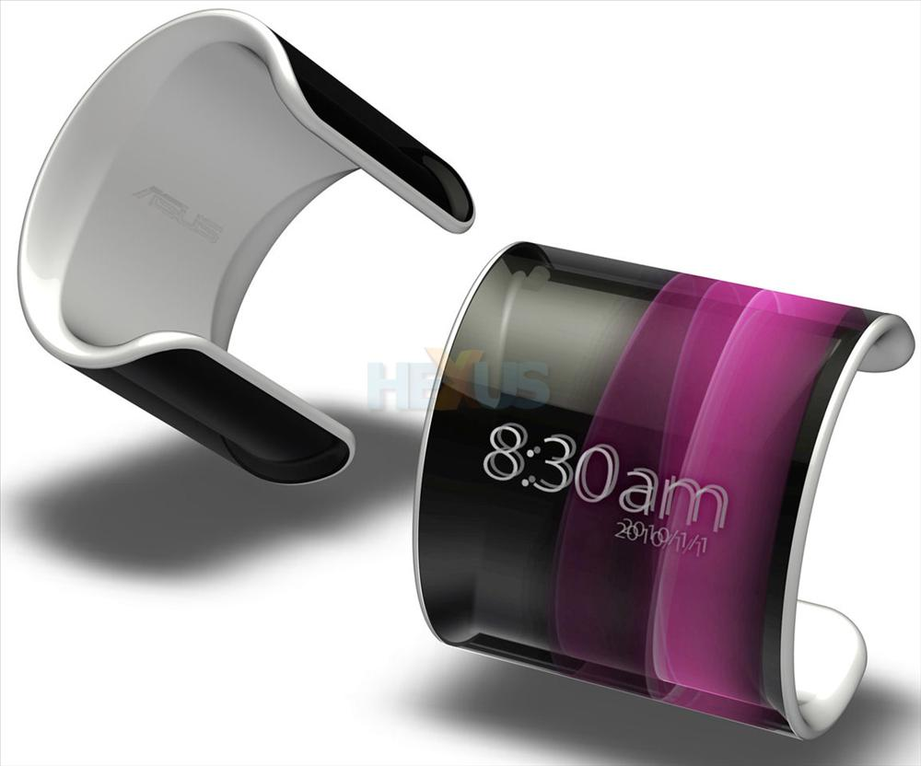
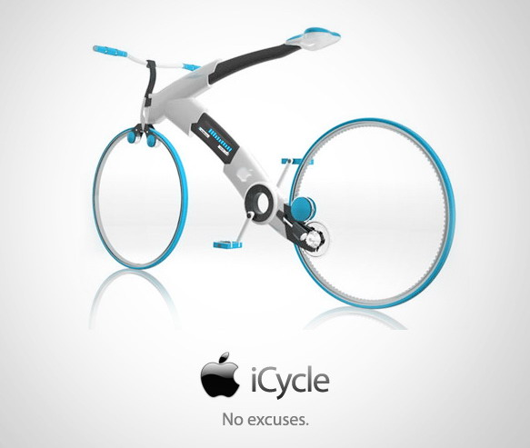
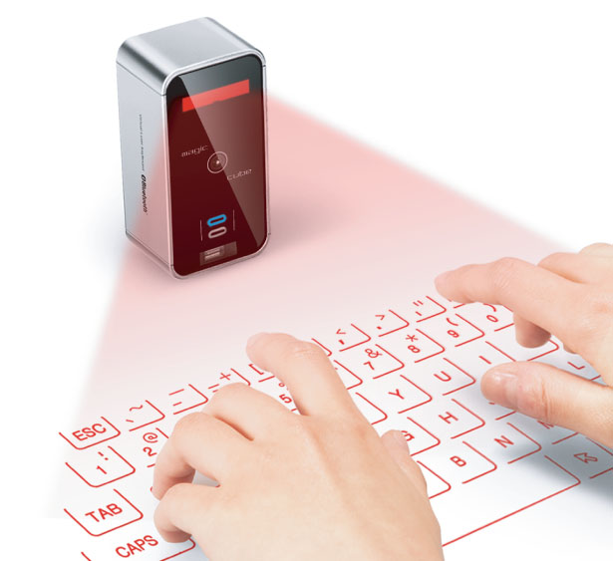
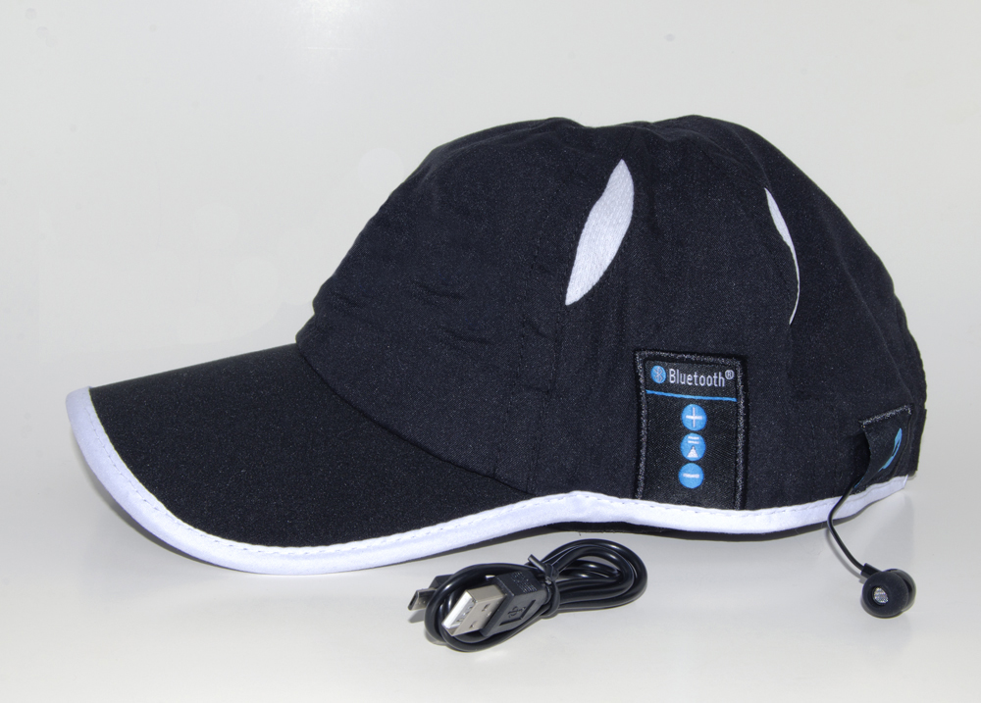

Level of Product
It includes all possible augmentations and transformations the product or offering might undergo in future.
Here companies search for new ways to satisfy customers an ddistinguish their offering.
Potential
Product
2/5/2019 10:03 PM

Slide 15

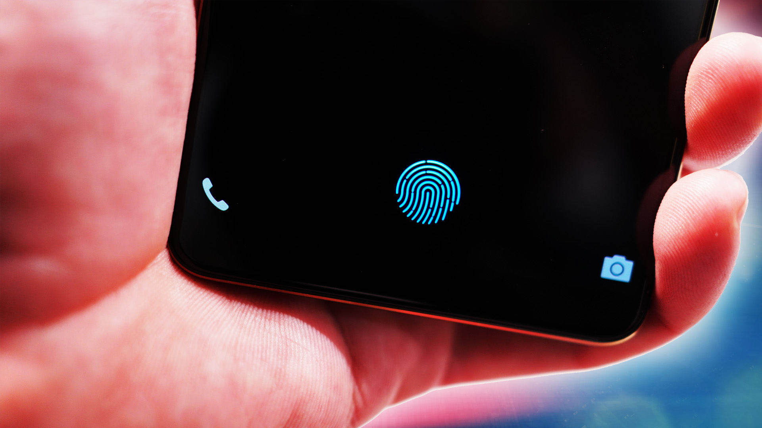
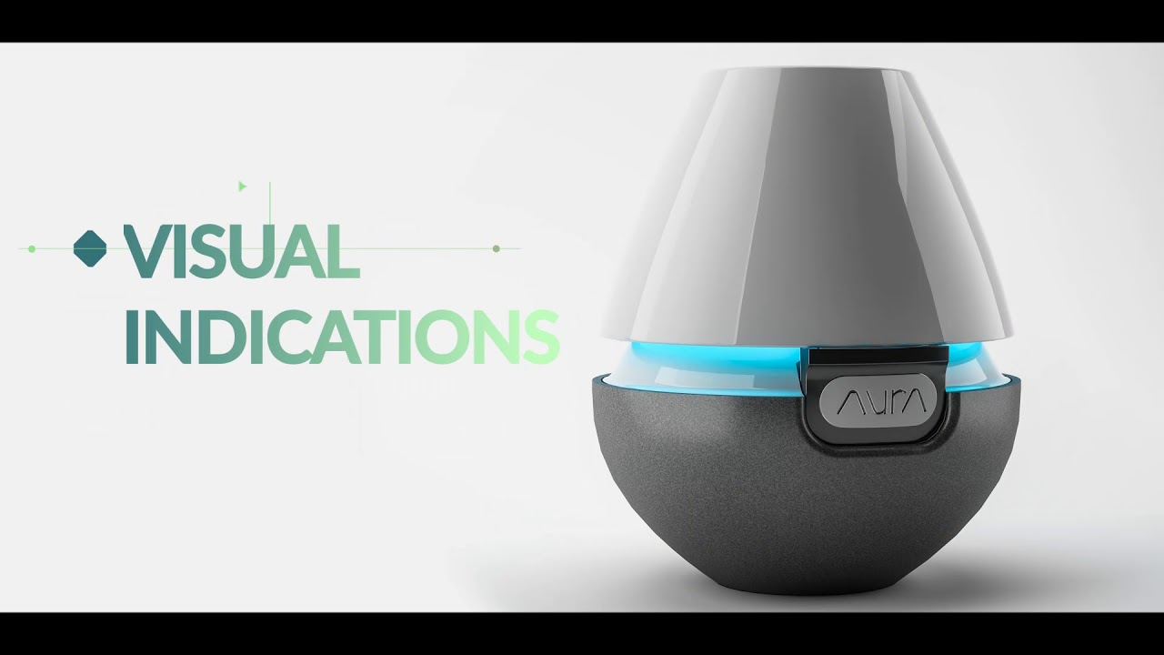

Level of Product
Potential
Product
2/5/2019 10:03 PM

Slide 16
Level of Product
Core
Product
Basic/Actual Product
Expected Product
Augmented Product
Potential Product
2/5/2019 10:03 PM

Slide 17
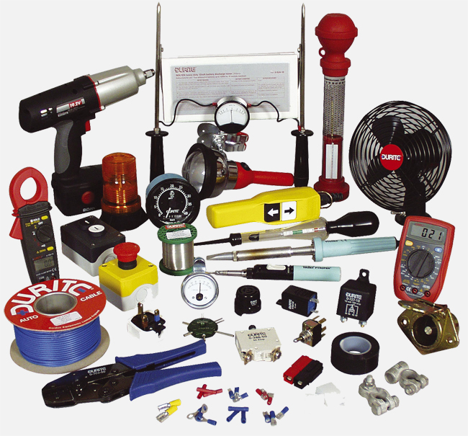

Types of Product/product classification
Product
Consumer Product
Industrial Product
Convenience
Shopping
Specialty
Unsought
Material and parts
Capital items
Supplies and services
2/5/2019 10:03 PM

Slide 18
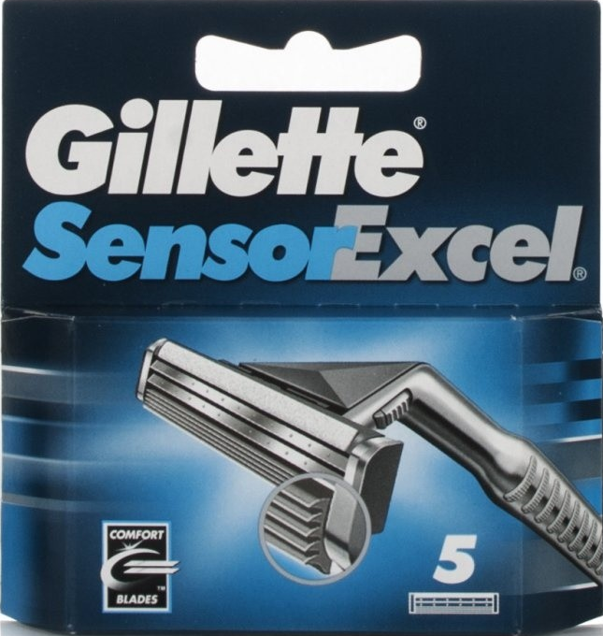
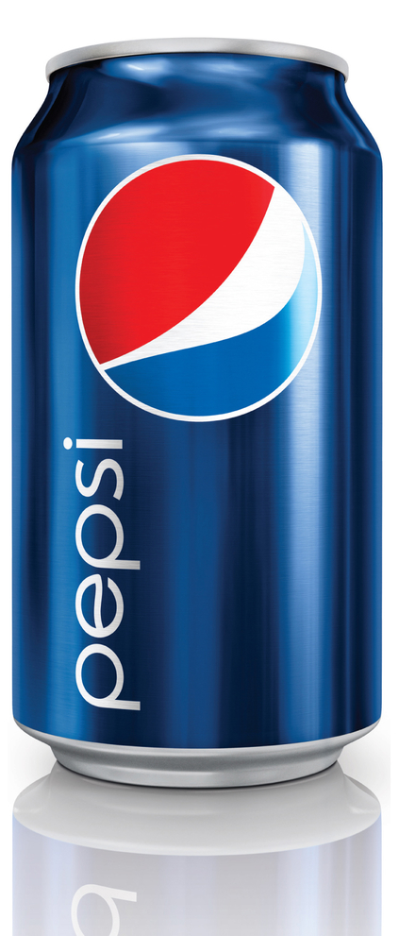
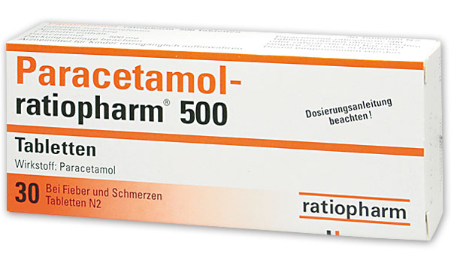
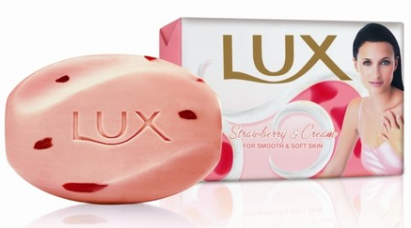
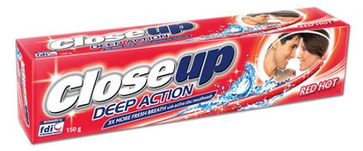
Types of Product/product classification
Convenience Product
Features
Purchased easily and often.
Frequently purchase.
Immediate decision.
Minimal effort.
Unplanned purchased.
Low involvement.
Brand awareness is high.
Packaging is important for buying decision.
Low price.
Bought from convenient retail outlets.
E.g. bread, newspaper, cigarette, sweets etc.
Consumer Product
2/5/2019 10:03 PM

Slide 19
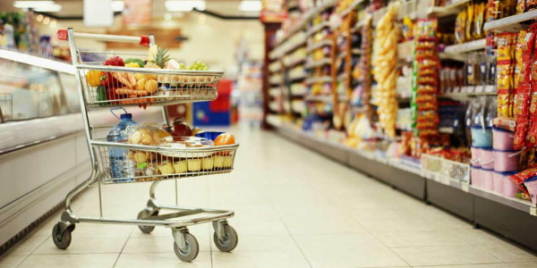
Types of Product/product classification
Convenience Product
Marketing considerations for convenience products
Convenience products are normally packaged and attractive.
Sold under a brand name.
Brand loyalty is promoted.
Standardized products.
Mass production and low price.
Low profit margin strategy.
Aggressively advertised.
Sales promotion generally lies with the manufactures.
Intensive distribution through many retail outlets and
wholesalers.
Consumer Product
2/5/2019 10:03 PM

Slide 20
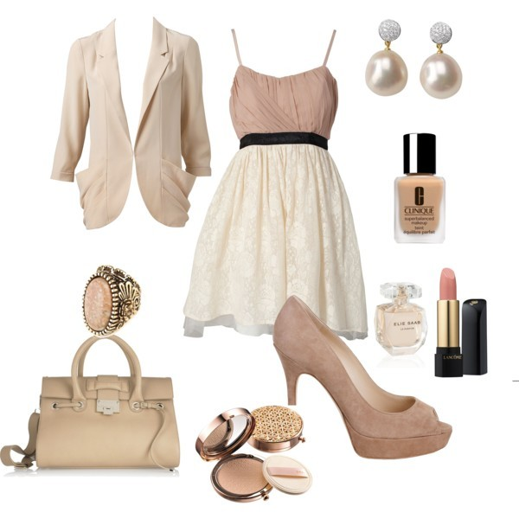
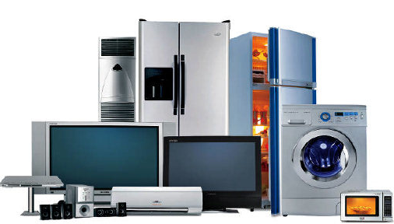
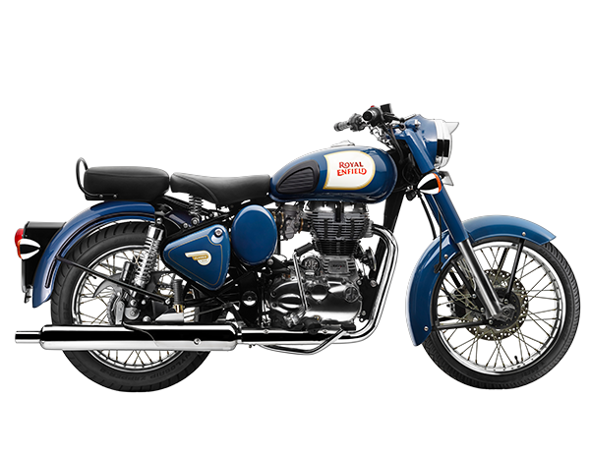
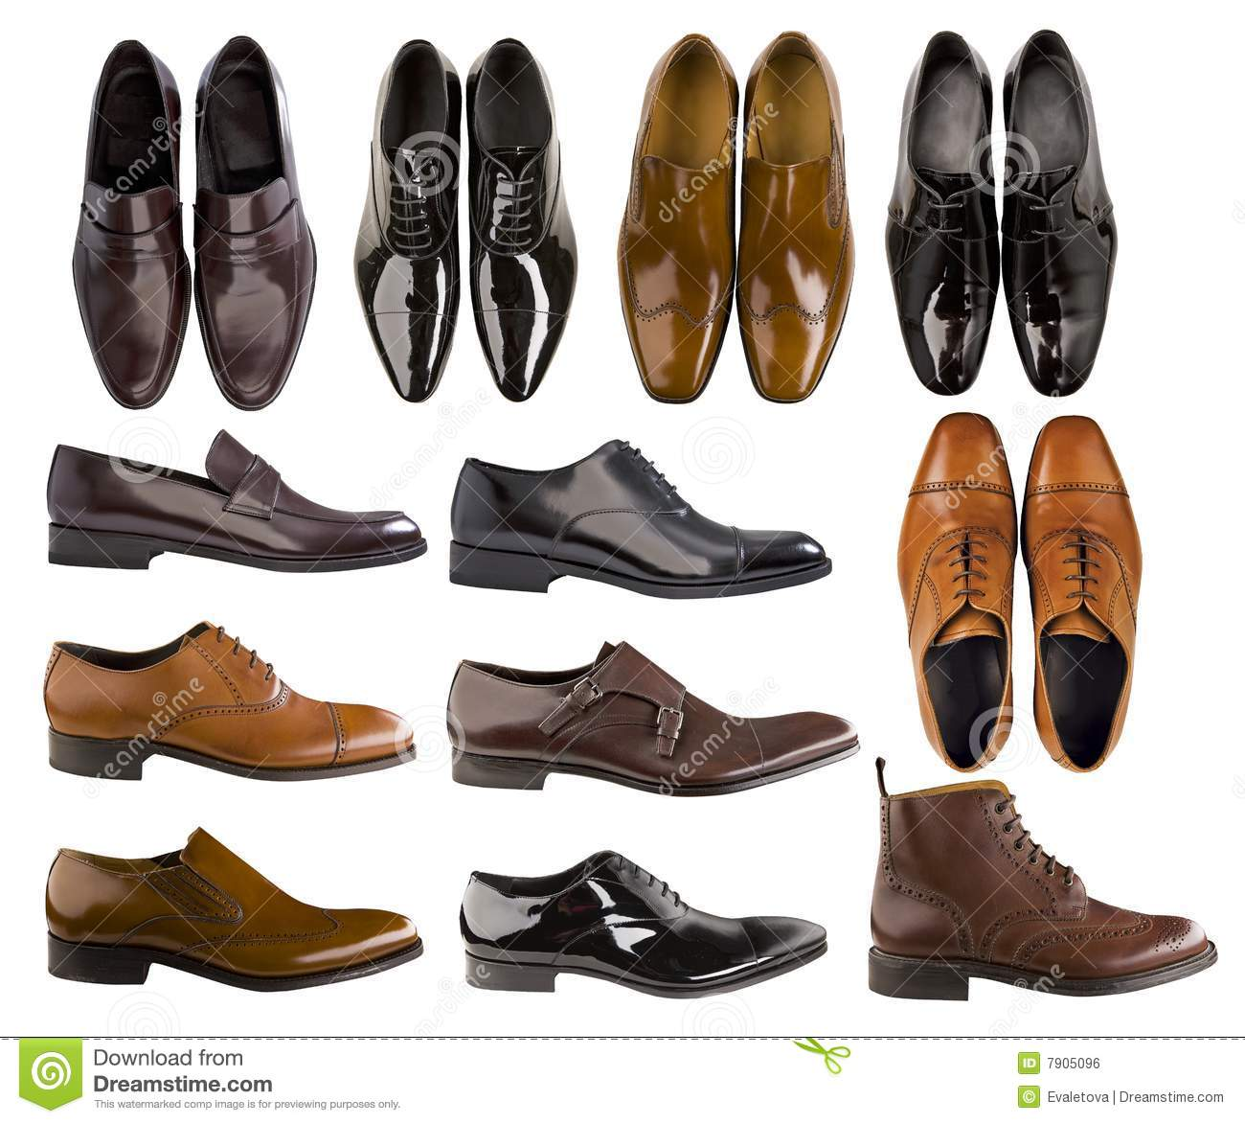
Types of Product/product classification
Shopping Product
Features
Less frequently purchased.
Products are consumed slowly.
One purchase will last for long.
Brand awareness and loyalty is low.
Higher priced than convenience products.
Considerable purchase effort is needed.
Buyer plans and make the decisions.
Costumer generally compare price, quality other factors.
Packaging is less important.
Bought at selective outlets.
Moderate to high involvement.
E.g. fashion clothes, shoes, furniture, electrical appliances, motorbikes.
Consumer Product
2/5/2019 10:03 PM

Slide 21
Types of Product/product classification
Shopping Product
Marketing considerations for shopping products
The reputation of the manufactures and the retailer play more important role in marketing than the brand name of the product.
Packaging should be appropriate but has less important role.
Sold through fewer retail outlets.
Price is usually high.
Shorter channel of distribution.
Personal selling is important and advertising is done by retailers at local level.
Store display.
After sales service and warranties and other offerings are considerable factors.
Clustered definite market: e.g. Dillibazar-Furniture, Teku & Maitidevi-Hardware, Newroad-Electronics, Ashon-Home appliances etc.
Consumer Product
2/5/2019 10:03 PM

Slide 22

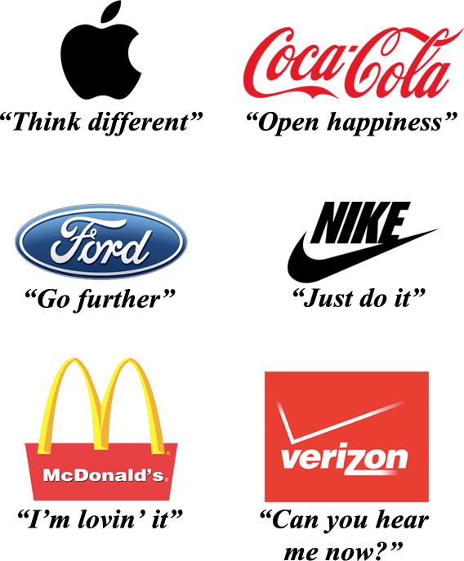
Types of Product/product classification
Specialty Product
Features
Product with durable type and unique features.
Purchase is well planned.
Strong brand preference and loyalty and do not accept substitute products.
Customers are ready to put an extra effort to purchase the products.
Purchase infrequently.
Packaging is less important.
Product may be found generally in high segments and is bought at exclusive outlets.
Consumer do not make comparison between various brands in terms of price, quality or services and is ready to discard any other brands for the patronized one.
E.g. Mercedes Benz Car, Benetton brand clothes, Rolex Watch.
Consumer Product
2/5/2019 10:03 PM

Slide 23
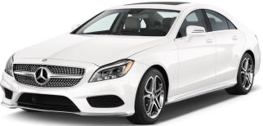
Types of Product/product classification
Specialty Product
Marketing considerations for specialty products
The marketing effort for specialty products is directed at maintaining the quality and unique features of the product.
Exclusive distribution through limited number of retail outlets/selective distribution or the service providers maintain their own outlets.
Advertising is targeted at making the group of loyal buyers aware about the availability and location of the retail outlets.
The manufacturer and the retailer jointly share the responsibility for promoting the specialty products.
Consumer Product
2/5/2019 10:03 PM

Slide 24
Types of Product/product classification
Unsought Product
Features
The consumers do not know or do not normally think of buying.
Little product awareness and knowledge and low desire to purchase and consume.
No purchase planning.
Branding is less important because there is no brand loyalty.
Price varies according to products.
Bought at specific outlets.
Consumers generally show reluctance to buy these products unless approached by the marketer.
Many of the new inventions are unsought by consumers until they become aware about its benefits.
E.g.: Insurance policies, magazine subscriptions, videophone, encyclopedias etc.
Consumer Product
2/5/2019 10:03 PM

Slide 25
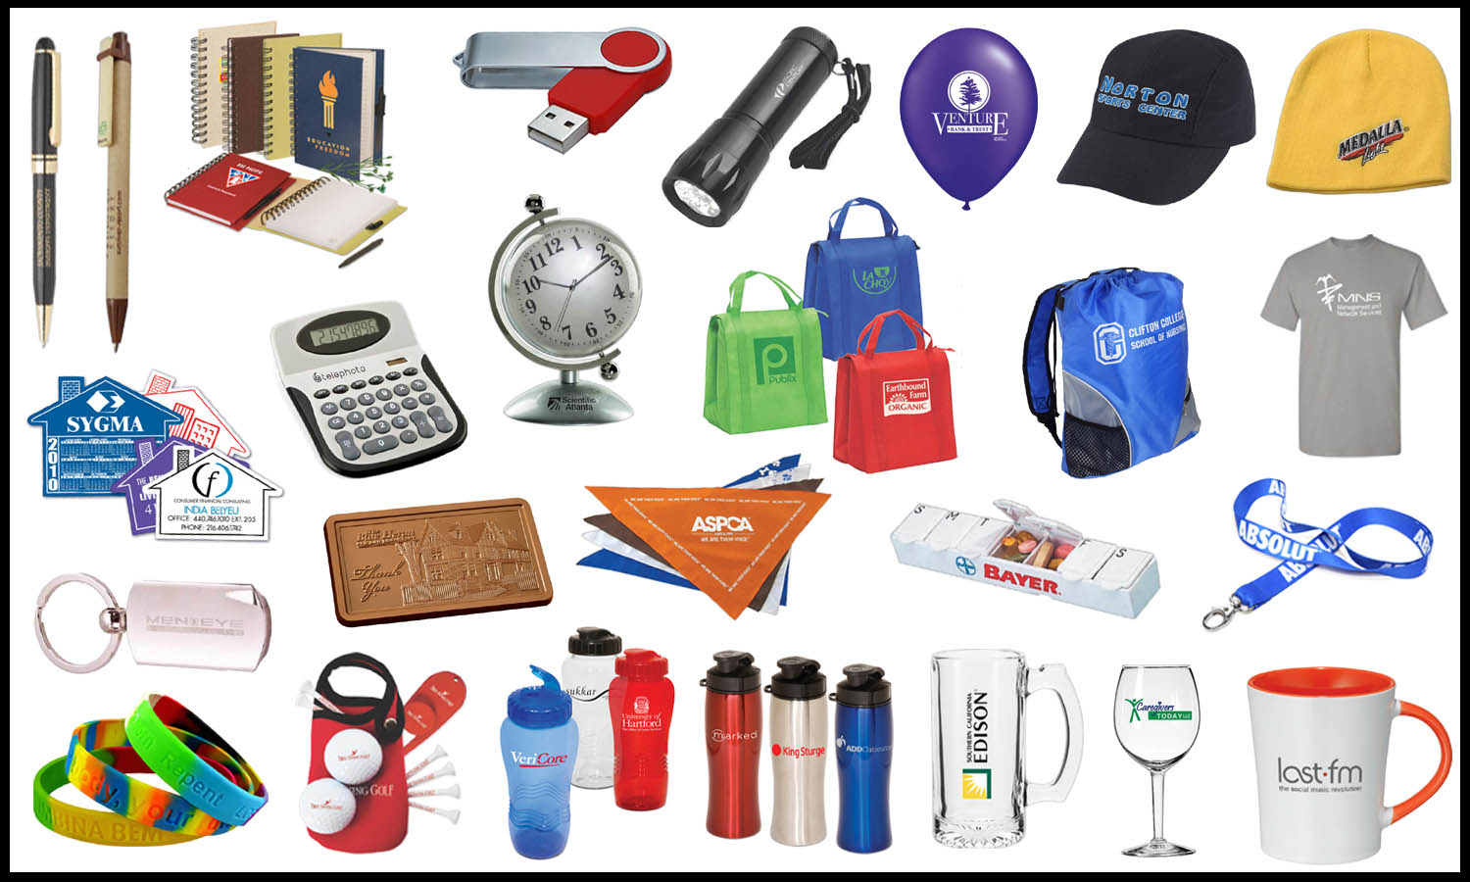
Types of Product/product classification
Unsought Product
Marketing considerations for unsought products
Consumer should be more aware of the product and the brand. So, aggressive selling effort is made.
The marketer has to use direct advertising, personal selling and sales promotion tools to create consumer interest on the product.
Packaging should be appropriate for the product.
Direct marketing is done by manufacturer through telemarketing, mail order outlets, websites.
Price is generally high because the product is new.
Consumer Product
2/5/2019 10:03 PM

Slide 26
Types of Product/product classification
Distinctive Features | Convenience | Shopping | Specialty | Unsought
Purchase frequency | Frequently | Less frequently | Infrequently | Rarely
Purchase planning | Minimal | High | Very high | None
Brand loyalty | Low | Low | High | None
Packaging | Very important | Less important | Less important | Importance varies
Price | Low | High | High | High
Place/Distribution | Intensive (Many retailers) | Selective (Few retailers) | Exclusive show rooms | Factory outlets
Marketing Considerations | Convenience | Shopping | Specialty | Unsought
Product features | Modify products | Improve features | Maintain quality | New product
Branding | Awareness | Image | Loyalty | Awareness
Packaging | Attractive | Useful protective | Not important | Appropriate
Pricing | Low price | High price | High price | High price
Place/Distribution | Long channels | Short channels | Very short channels | Direct channel
Promotion | National by producer | Local by retailer | Targeted promotion | National and local
2/5/2019 10:03 PM

Slide 27
Types of Product/product classification
Product
Consumer Product
Industrial Product
Convenience
Shopping
Specialty
Unsought
Material and parts
Capital items
Supplies and services
2/5/2019 10:03 PM

Slide 28
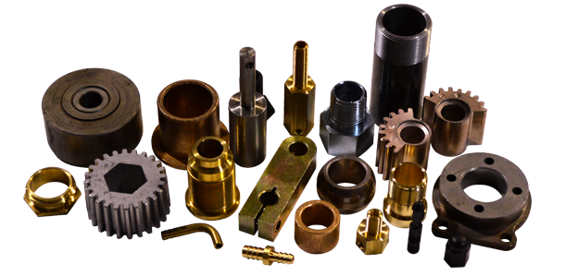

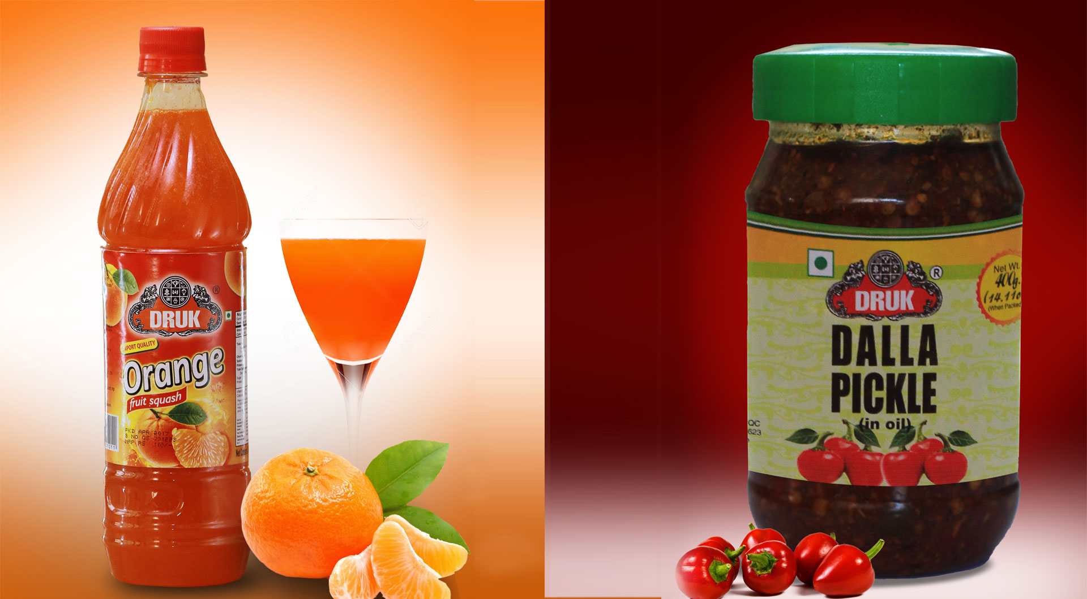

Types of Product/product classification
Materials and Parts
They are the items/goods which are the part of the final product. They are bought for further processing or for their own use.
Materials
Natural Products (e.g. fish, lumber, crude petroleum, iron etc.
Agricultural/Farm Products (e.g. wheat, cotton, livestock, fruits and vegetables etc.)
Parts
Industrial Product
2/5/2019 10:03 PM

Slide 29
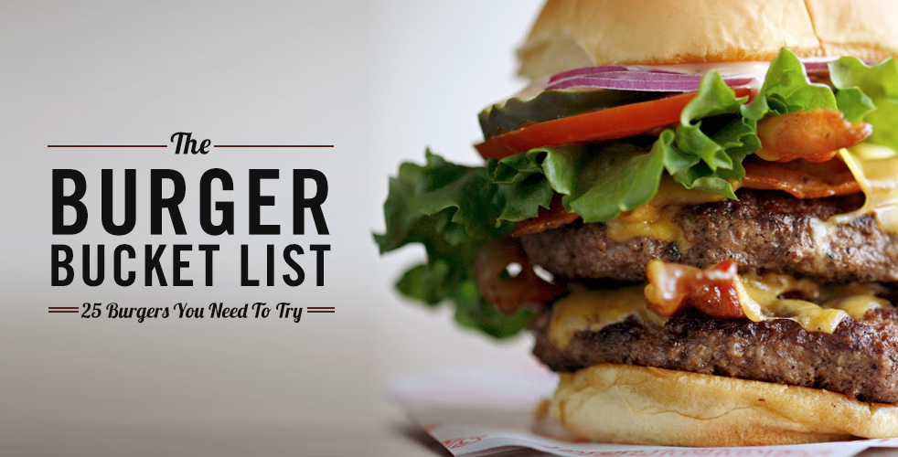
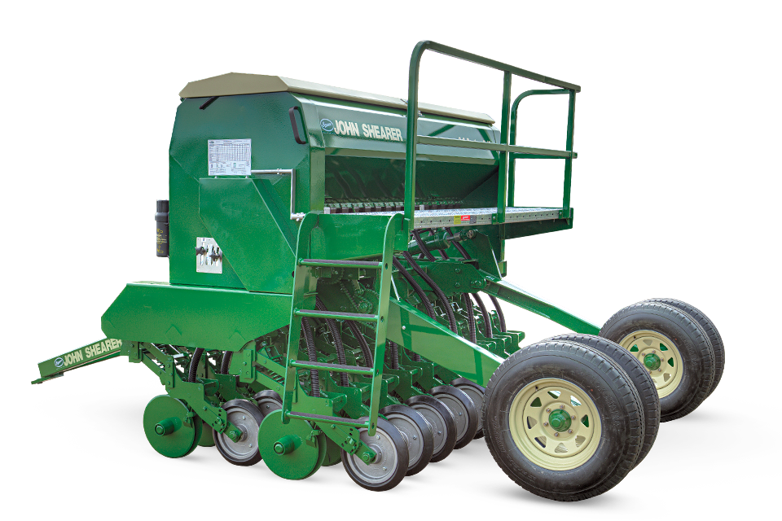
Types of Product/product classification
Materials and Parts
Materials
Raw materials consist of natural products and farm products. They change their form to become final product.
Industrial Product
Parts
Parts enter the finished products with no
further change in form, as when small motors
are put into vacuum cleaners and tires are put on
automobiles.
2/5/2019 10:03 PM

Slide 30
Types of Product/product classification
Marketing considerations for material and parts
In case of natural materials, the products are graded in terms of their basic contents and attributes.
Prices are largely negotiated between the supplier and the industrial users or decided according to the international market.
Direct channel link between the suppliers and the industrial user.
In case of agricultural materials, collection and gathering from small producers and transporting them to the place of processing are major marketing activities.
Price according to their quality grades or generally negotiation.
Due to seasonal factor, industrial users need to purchase and process the materials within a short period time.
In case of parts, the producers directly marketed to industrial users.
Manufactures prefer to contract a reliable supplier on a long term basis.
Price through negotiation.
Advertising, branding and packaging do not play important part in the marketing of parts.
Industrial Product
2/5/2019 10:03 PM

Slide 31
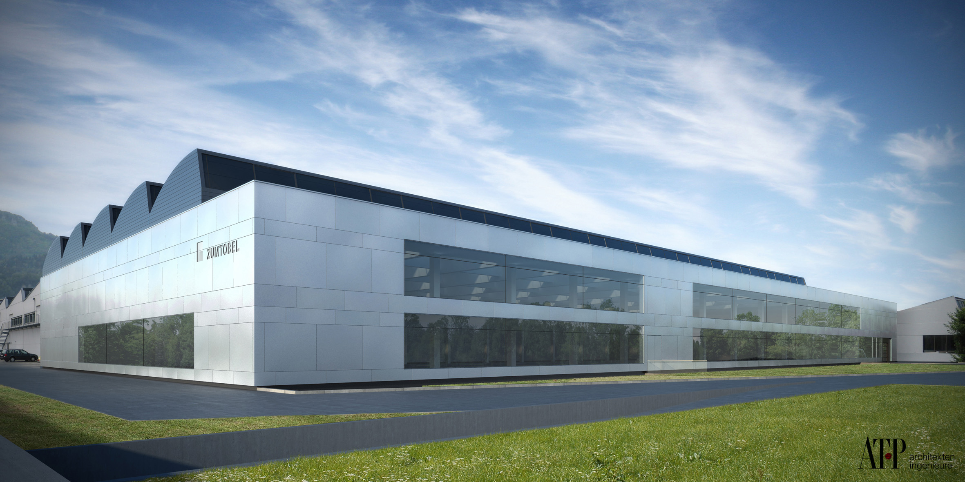
Types of Product/product classification
Capital Items/Goods
They are long lasting goods that facilitate production of the finished product.
They consists of Installation & Accessory Equipment
Installation
It consist of building, machinery and heavy equipment.
They are non movable, expensive and long-lived.
They affect the scale of operation.
They remain fixed in one place.
Do not need frequent purchasing.
Industrial Product
2/5/2019 10:03 PM

Slide 32
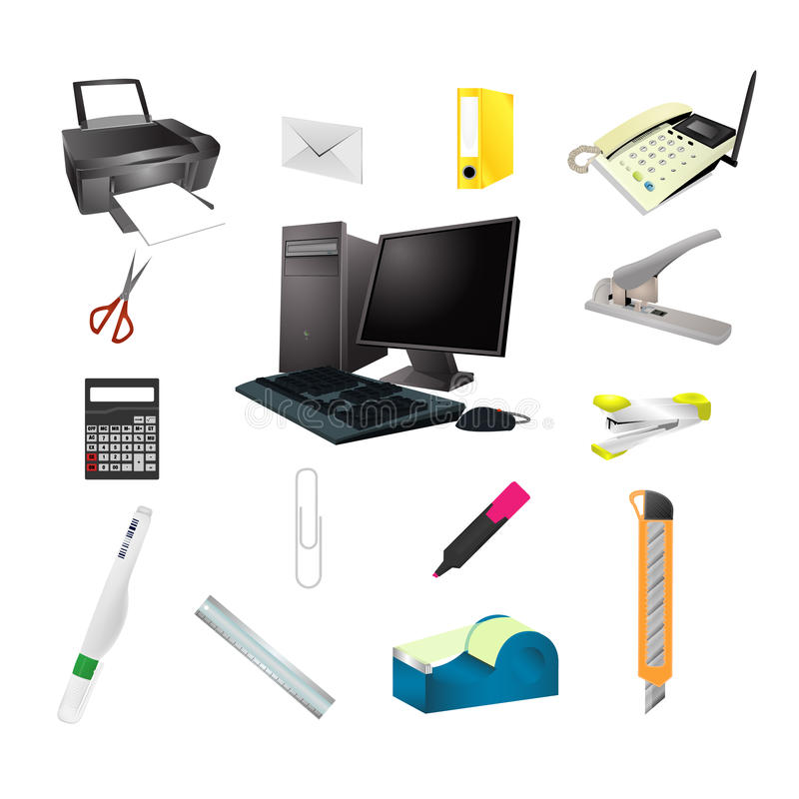
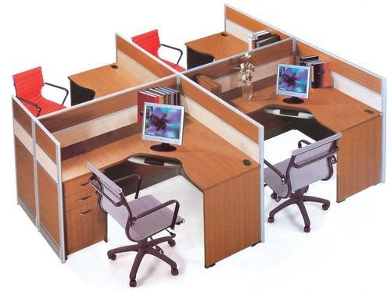
Types of Product/product classification
Capital Items/Goods
Accessory Equipment
It consist of movable equipment, tools and office equipment.
They help in production process and don’t become the part of a finished product.
They have shorter life span but a longer life than operating supplies.
Equipment is less expensive, purchased routinely and treated as expense item.
Industrial Product
2/5/2019 10:03 PM

Slide 33
Types of Product/product classification
Capital Items/Goods
Marketing considerations for capital items
Installation
Reputation of the manufacturer is the single most important factor.
Purchase installations directly from manufacturers.
Installation requires regular maintenance and servicing that are provided by the manufacturer.
Personal selling is used for promotion, although many manufacturers also launch publicity and public relation campaigns to enhance to company image.
Accessory equipment
If the order value is high, they market directly to industrial user and if the order value is small they sell through industrial distributors.
Low priced equipment, such as a tools and office equipment are marketed through retail outlets.
Company reputation as well as brand name plays important part in marketing.
Products are generally standardized and should be supported by warranty, repair and replacement of parts.
Industrial Product
2/5/2019 10:03 PM

Slide 34
Types of Product/product classification
Supplies & Business Services
They are goods and services that facilitate developing and managing
the finished product.
Supplies Types: Maintenance and Repair Items & Operating Supplies
Maintenance and Repair Items
It include a variety of support services required by an organization.
E.g. Paint, nails, brooms etc.
Operating Supplies
It helps in production or in providing services to customers.
They are the low priced, short-lived and frequently purchased industrial products.
Often termed as convenience products of the industry which are purchased with minimum effort on a straight-rebuy basis.
E.g. Fuel, Lubricants, Paper, Carbons etc.
Industrial Product
2/5/2019 10:03 PM

Slide 35
Types of Product/product classification
Supplies & Business Services
They are goods and services that facilitate developing and managing
the finished product.
Business Services
It include maintenance and repair services.
Business services include maintenance and repair services (window cleaning, copier repair) and business advisory services (legal, management consulting, advertising). Maintenance and repair services are usually supplied under contract by small producers or from the manufacturers of the original equipment whereas, Business advisory services are usually purchased on the basis of the supplier’s reputation and staff.
Industrial Product
2/5/2019 10:03 PM

Slide 36
Types of Product/product classification
Supplies & Business Services
Marketing considerations for operating supplies
Marketed through retail outlets, for which the marketer has to adopt the long channel of distribution.
Branding and packaging do not play vital role in marketing.
They are extensively advertised because many of the industrial operating supplies are used for personal consumption.
Marketing considerations for business services
Marketed directly to the organizations.
The service provider personally contacts the organization; negotiates the terms and conditions; and enters into a long term contract to provide the services.
Industrial Product
2/5/2019 10:03 PM

Slide 37

Product Life cycle
Products are like human beings which are conceived, born, grow, achieve maturity and finally die.
All products have a life cycle and no product sell forever.
Changes in technology, competition and buyer’s preferences limit any product’s life.
Different groups of consumers have different buying patterns/behavior and they buy the product at different periods of time.
Product sales pass through different stages and the profit rise and fall at different stages of product life cycle.
Marketing strategies should differ in each stage of product life cycle.
2/5/2019 10:03 PM

Slide 38


Product Life cycle
Philip Kotler:
‘The product life cycle is an attempt to recognize distinct stages in the sales history of the product.’
William Stanton:
‘A product life cycle consists of the aggregate demand over an extended period of time for all brands comprising a generic product category.’
2/5/2019 10:03 PM

Slide 39
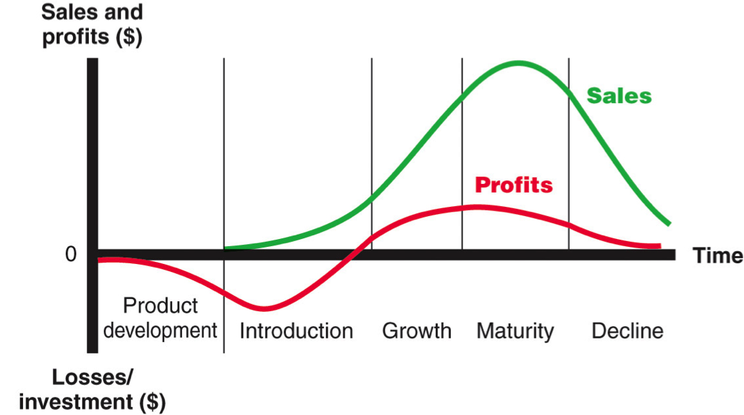
Product Life cycle
2/5/2019 10:03 PM

Slide 40
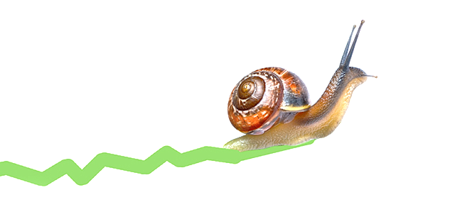
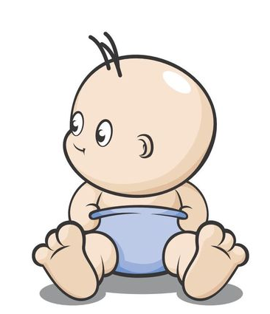
Product Life cycle
Introduction Stage
A period of slow sales growth as the product is introduced in the market. Profits are nonexistent because of the heavy expenses of product introduction.
Characteristics
Slow growth of sales
Market pioneers buy the product
Small production level
Technological problems
Higher price
Negative or low profit
No competitors
Innovator customers
2/5/2019 10:03 PM

Slide 41


Product Life cycle
Growth Stage
A period of rapid market acceptance and substantial profit improvement.
Characteristics
Sales increase rapidly
New buyer groups
Technological improvement and new features
New market segment
Stable price and promotion
Rising or high profit
Growing competition
Slightly lower price
2/5/2019 10:03 PM

Slide 42


Product Life cycle
Maturity Stage
A period of defending market share where the market objective is to stabilize profit and defend market share. This stage last long. Slowdown in sales growth because the product has achieved acceptance by most potential buyers. Profits stabilize or decline because of increased competition.
Characteristics
Sales at peak and slowdown
Tough competition
Price cuts
Heavy promotion
Stable profit
Lowest price
2/5/2019 10:03 PM

Slide 43


Product Life cycle
Decline Stage
A period of declining in sales and profit. The marketing objective is to survive and eventually withdraw from the market.
Characteristics
Declining sales
Declining profit
Laggard customer
Declining competition
Increased price
2/5/2019 10:03 PM

Slide 44
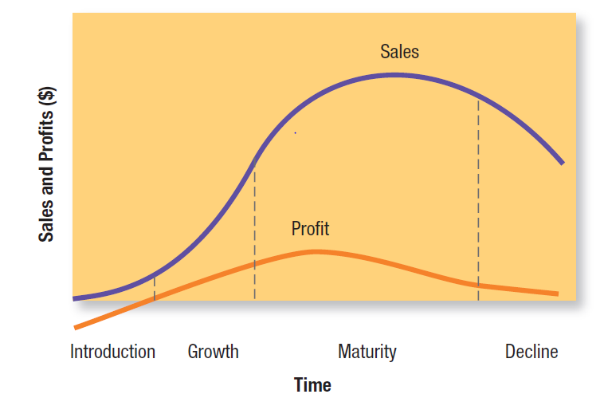
Product Life cycle
2/5/2019 10:03 PM

Slide 45
Product Life cycle
Product life cycle is the course of a product’s sales and profit over time.
PCL deals with the life of a product in the market with respect to business or commercial costs and sales measures.
Introduction Stage
Growth Stage
Maturity Stage
Decline Stage
2/5/2019 10:03 PM

Slide 46
Product Life cycle
Introduction Stage
Sales Low
Cost High cost per customer
Profits Negative or minimum
Marketing objectives Create product awareness and trail
Product New product, Innovation
Price Use cost-plus formula (Penetration or Skimming)
Distribution Build selective distribution
Promotion Heavy to entice product trial
2/5/2019 10:03 PM

Slide 47
Product Life cycle
Growth Stage
Sales Rapidly rising
Cost Average cost per customer
Profits Rising
Marketing objectives Maximize market share
Product Improves product quality, adds new features, improved styling, service, warranty
Price Penetration strategy
Distribution Build intensive distribution and also enter new market
Promotion Shifts from awareness and trial communications to preference and loyalty communications.
2/5/2019 10:03 PM

Slide 48
Product Life cycle
Maturity Stage
Sales Peak
Cost Low cost per customer
Profits High
Marketing objectives Maximize profits while defending market share
Product Diversify brand and models
Price Match or best competitors
Distribution Build more intensive distribution
Promotion Increase to encourage brand switching
2/5/2019 10:03 PM

Slide 49
Product Life cycle
Decline Stage
Sales Declining
Cost Low cost per customer
Profits Decline
Marketing objectives Reduce expenditures and milk the brand
Product Phase out weak items
Price Cut price
Distribution Selective: Phase out unprofitable outlets
Promotion Reduce to minimum level
2/5/2019 10:03 PM

Slide 50
Product Life cycle strategies- Introduction stage
Product:
A new product is offered as the “first” in the market.
The product mix is small. Product innovation is done.
Price:
The pricing method used is generally cost-plus basis. The alternative strategies can be: Market skimming and Market penetration.
Promotion:
The level of promotion is high. Advertising is used to build product awareness. Sales promotion is used to promote product trial.
Place:
Selective distribution channels are used for distribution of the product.
2/5/2019 10:03 PM

Slide 51
Product Life cycle strategies- Growth stage
Product:
Improves product quality and adds new features and
improved styling. Adds new models and flanker products (i.e. products of different sizes, flavors and so that to protect the main product.) Different service and warranty are provided. It enters new market segments.
Price:
It is slightly lowered to penetrate the market and attract price-sensitive customers.
Promotion:
Its expenses are slightly increased. Advertising shifts from product awareness to product preference and acceptance. Brand loyalty is emphasized and the promotion is done to pull the customers.
Place:
Intensive distribution is done to increase market coverage. Distributors feel interested in the product. New market segments are served.
2/5/2019 10:03 PM

Slide 52
Product Life cycle strategies- Maturity stage
Product:
Quality improvement: Aims at increasing the product’s functional
performance.
Features improvement: Aims at adding new features, such as size, weight, materials, additives and accessories that expand the product’s performance, versatility, safety or convenience.
Style improvement: Aims at increasing the product’s esthetics appeal.
Price:
It is competition based. They are generally low.
Promotion:
Brand Loyalty is emphasized. Advertising is redesigned to stress brand differences and benefits. Sales promotion is increased and modify to encourage brand switching. Post sale services are offered. Dealer promotion is done to push the product.
Place:
More intensive distribution strategy is followed. New distribution channels are used.
2/5/2019 10:03 PM

Slide 53
Product Life cycle strategies- decline stage
Product:
Weaker products are phased out. Brands are reduced. Product offer
is rationalized. Market niches are catered (make satisfied).
Price:
Generally low price is offered to the customer where as, high price strategy is used for loyal customers.
Promotion:
Promotion is done for reinforcement (strengthening). Advertisement is done to retain loyal customers. Sales promotion is minimal or none.
Place:
Distribution strategy is made more selective. Unprofitable channels are phased out.
2/5/2019 10:03 PM

Slide 54
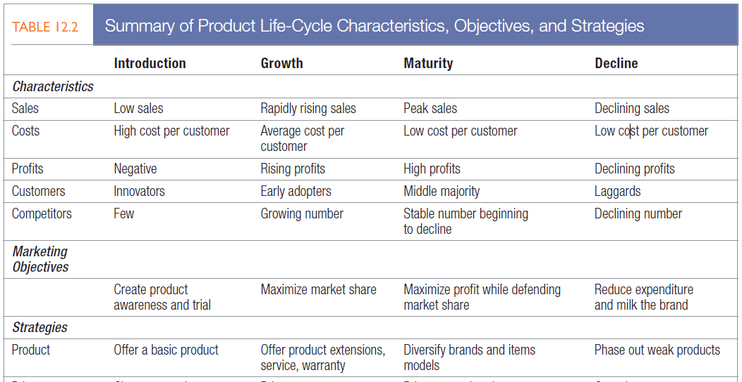
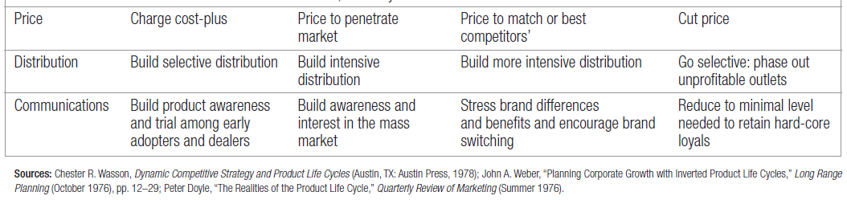
Product Life cycle
2/5/2019 10:03 PM

Slide 55

New product
Philip Kotler:
New products include original products, improved products, modified products, and new brands that the firm develops.
William J. Stanton
If buyers consider it to be significantly different from competitive products in some relevant characteristics (such as appearance or performance), then it is indeed a new product.
Product innovations
Product modifications
Product imitations (copy)
2/5/2019 10:03 PM

Slide 56
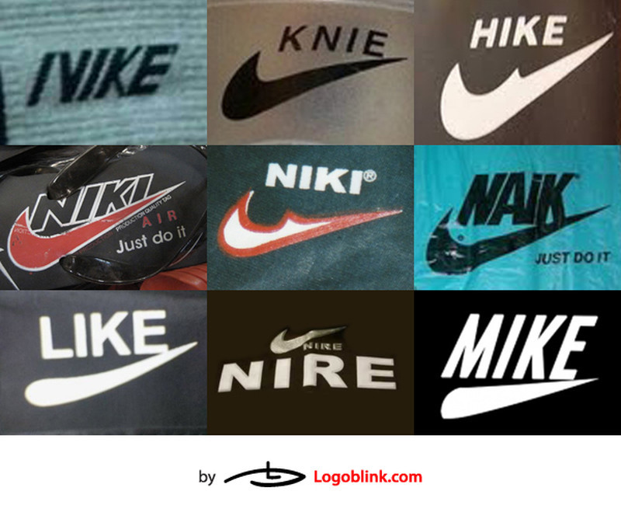
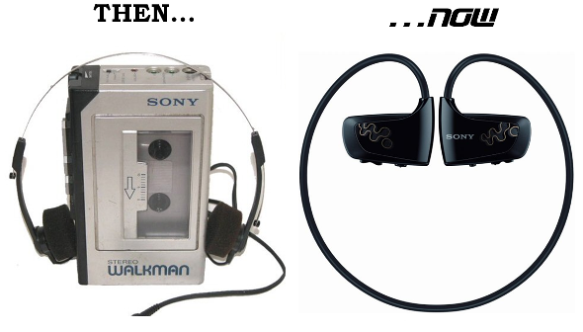

New product
Product innovations
Product modifications- Quality, Function and Benefit
Product imitations (copy)
2/5/2019 10:03 PM

Slide 57

New product development process
Idea Generation
Idea Screening
Concept Development & Testing
Marketing Strategy Development
Business Analysis
Product Development
Test Marketing
Commercialization
2/5/2019 10:03 PM

Slide 58
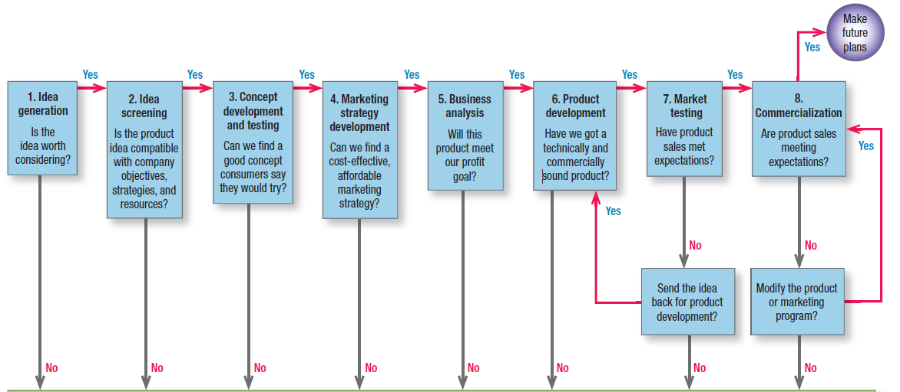
New product development process
2/5/2019 10:03 PM

Slide 59
New product development process
Idea Generation
In order to develop a successful new product an organization needs to develop several product ideas.
Sources of product ideas:
Executives- Scientists, engineers, research team etc.
Customers- Listening complaints and suggestions, formal surveys etc.
Competitors- In terms of raw materials, technology & production process.
Marketing intermediaries- Suppliers, distributors, retailers,
Other sources of ideas- Trade journals, magazines, seminars, publications of government research agencies and universities, individual inventors, industrial consultants, market research agencies and advertising agencies etc.
2/5/2019 10:03 PM

Slide 60

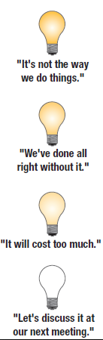
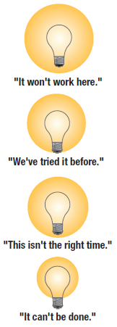
New product development process
Idea Screening
Not all ideas are good ones. Marketers need to test consumer reaction to their idea before they continue. Throw the idea around and see what people think.
It is a preliminary elimination process in which a large number of product ideas are screened in terms of the organization’s objectives, policies, technical feasibility and financial availability.
Total Ideas
Promising Ideas
Marginal Ideas
Rejected Ideas
2/5/2019 10:03 PM

Slide 61
New product development process
Concept development and testing
Concept Development:
Promising ideas are turned into product concepts which is elaborated version of the ideas expressed in customer terms.
Precise description of the product with its uses and benefits.
Physical prototype or drawings of how the product looks like.
Concept Testing:
A concept testing is asking potential customers to evaluate description of product concept. Interview questions may be related with:
Uniqueness of the product, clarity of the concept, need satisfying attributes of the concept, buying intent, price-value perception, frequency of potential use etc.
2/5/2019 10:03 PM

Slide 62
New product development process
Marketing Strategy Development
It is the preliminary marketing strategy for the successful product concepts. Such a marketing strategy includes the following aspects:
The target market for the product.
Possible positioning for the product.
Preliminary estimate of sales, market share and profits from the product during the first few years.
The products planned price, distribution and promotion program.
Long-term sales, profit and marketing strategy for the product.
2/5/2019 10:03 PM

Slide 63
New product development process
Business Analysis
It involves drawing a sketch of a product’s compatibility with the market including specific estimates of sales, costs and profits. It is done to evaluate the product concept’s business attractiveness which involves:
Competitor analysis
Demand forecast
Cost statement and break even analysis to estimate costs.
Profit projections
Organization’s financial position, manpower and technical resources.
Possibility of resource expansion.
“Can we make and sell this product and make money doing it?”
2/5/2019 10:03 PM

Slide 64

New product development process
Product Development
The organization develop the physical versions of the product and prepares prototypes for laboratory and consumer level tests.
2/5/2019 10:03 PM

Slide 65
New product development process
Test Marketing
It attempts to test on a limited scale the commercial viability of a new product and the marketing mix designed for the product in the context of a market segment.
Purpose for test marketing:
1. To provide a reasonable estimate of sales and market share for the product.
2. To correct the marketing mix for the product.
Usually occurs by offering the product to a random sample of the target market.
Customer feedback is used to improve the venture and determine whether the product should “go to market”
Test acceptance of the product
2/5/2019 10:03 PM

Slide 66
New product development process
Commercialization
It is the last step in the new product development stage which involves commercial lunching of the product in the target markets which is based on the test marketing results.
The “Product Life Cycle” begins and it’s life will be determined by the customer market, competition and further product advances.
Major decision during commercialization:
1. Timing decision (when)
2. Place decision (where)
3. Market segment decision (whom)
4. Launching strategy decision (how)
2/5/2019 10:03 PM

Slide 67
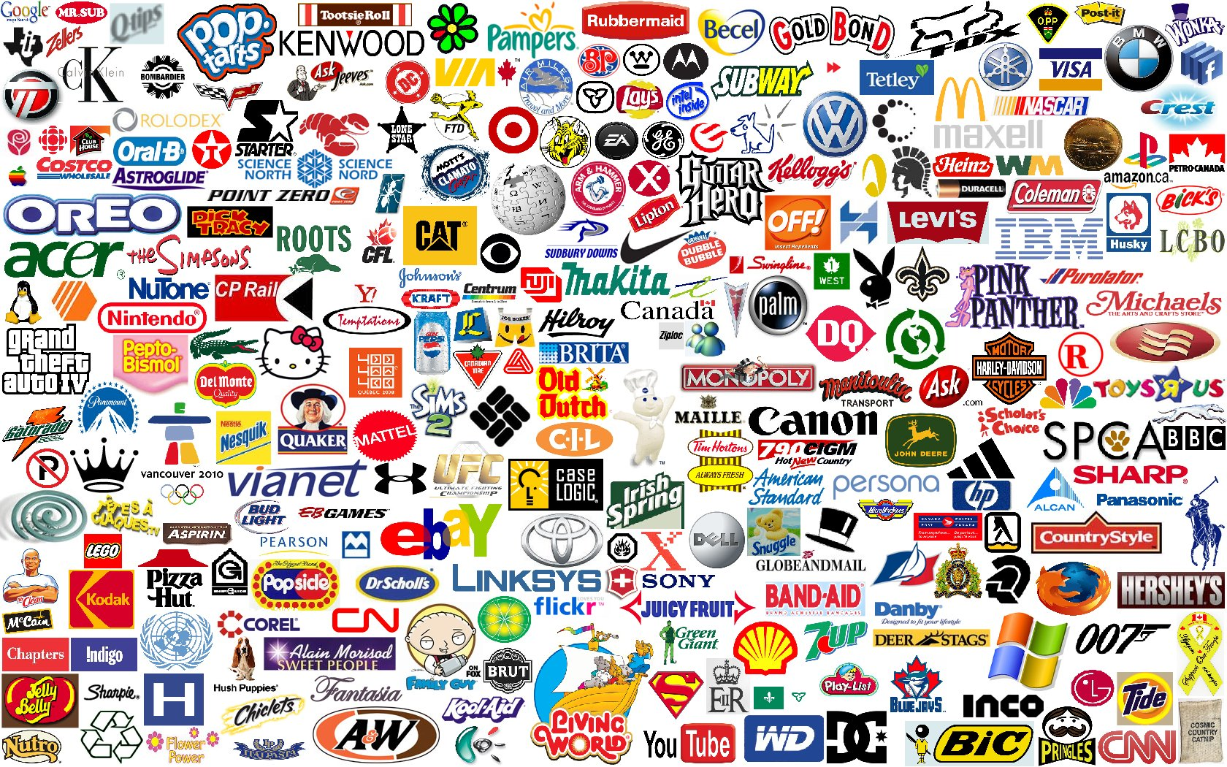
Branding
2/5/2019 10:03 PM

Slide 68
What is a Brand???
A name, term, sign, symbol or design, or a combination of them, intended to identify the goods or services of one seller or group of sellers and to differentiate them from those of competitors.
What is Branding???
Providing goods and services with the power of the brand.
Branding is the process of giving a meaning to specific products by creating and shaping a brand in consumers’ minds. It is a strategy designed by companies to help people to quickly identify their products and organization, and give them a reason to choose their products over the competition’s, by clarifying what this particular brand is and is not.
http://www.thebrandingjournal.com/2015/10/what-is-branding-definition/
Brand Name
Brand Mark
Trade Mark
2/5/2019 10:03 PM

Slide 69
branding
William Stanton
“A brand is a name and or mark intended to identify the product of one seller or group of sellers an differentiate the product from competing products.”
Philip Kotler
“A brand is a name, term, sign, symbol or design, or a combination of them, intended to identify the goods or services of one sellers and to differentiate them from those of competitors.”
Reasons for not branding:
High Cost
Low Quality
Perishable Products
Homogeneous Products
Legal Formalities
Reasons for branding:
Product identification and choice
Reduction in search and evaluation time
Quality assurance
Prestige and status
Reduction of risk
Image enhancement
2/5/2019 10:03 PM

Slide 70
Importance/Objectives of branding
Efficiency in marketing
Context of Organization
Expansion of product line
Promotion
Value Building
*Quality Certification
Brand Loyalty
Product Positioning
Legal protection
Product image and personality development
2/5/2019 10:03 PM

Slide 71

Importance/Objectives of branding
*Quality Certification
REQUIREMENTS OF ISO 9001 CERTIFICATION STANDARD
ISO 9001:2008 certification standard is based on following basic principles :-
Management commitment,
Customer focus,
Quality policy,
Quality objectives,
QMS planning,
Deciding Responsibility & authority,
Management review,
Resource management,
Product/Services realization,
Measurement analysis and improvement.
http://isonepal.com/iso-9001-certification-nepal.html
2/5/2019 10:03 PM

Slide 72
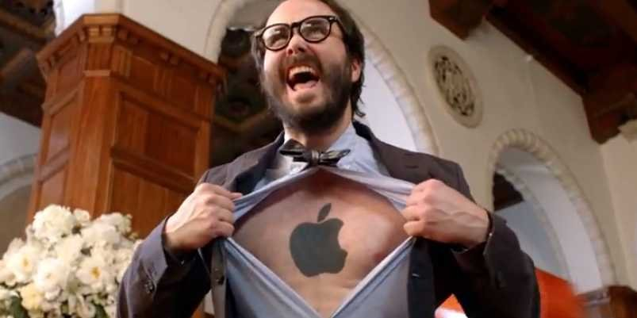

Importance/Objectives of branding
Context of Customer
Product identification
Quality assurance
Prestige and status
Context of Society
Event promotion
Consumer welfare
Environmental protection
2/5/2019 10:03 PM

Slide 73
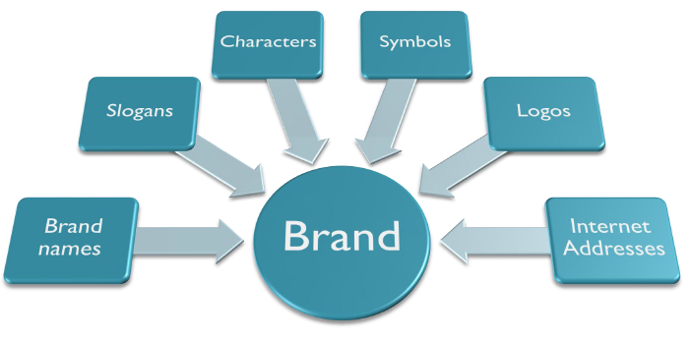
Brand elements
?
?
?
?
?
?
2/5/2019 10:03 PM

Slide 74
Types of branding
Ownership Based
Distributor Brand
Licensed Brand
Manufacturer Brand
Product Line Based
Family Brand
Individual Brand
2/5/2019 10:03 PM

Slide 75
Types of branding
Product Line Based
Individual Brands
- Each product is branded as a separate name.
- Surya Tobacco Company has individual brand policy and has used cigarettes; Surya, Shikhar, Naulo, Khukuri, Chautari and Bijuli.
Merits of Individual Brands
It can be targeted at a different market segment and separately positioned in the market.
The technical fault or some other problems associated with one brand does not affect the image of other brand.
Marketers can adopt separate marketing mixes for individual brands.
Brands can be effectively controlled.
Demerits of Individual Brands
Heavy promotion and budget.
Need separate brand managers to handle the brands.
Does not help the marketer to build the corporate image based on a successful brand name.
Individual brand policy is difficult to maintain and manage.
2/5/2019 10:03 PM

Slide 76
Types of branding
Product Line Based
Family Brands
- It involves branding using a single name for all product items under a product line or mix.
- Sony Electronics and Honda use the family branding policy.
Merits of Family Brands
- Less promotion cost.
- All product under the same brand name can be promoted easily under a blanket advertising campaign.
- It makes the introduction of a new product very convenient.
- Marketers can adopt common marketing program for a variety of product under the family branding.
- Marketers can build their corporate image based on the brand name.
Demerits of Family Brands
- If products have different quality levels, family branding confuses consumers.
- Technical and market related problem in one product may adversely affect the image of other products under the same name.
2/5/2019 10:03 PM

Slide 77


Slide 78
Family Brand
2/5/2019 10:03 PM

Slide 79


Slide 80
Individual Brand
2/5/2019 10:03 PM

Slide 81

Features of a good brand
- It should suggest something about the product’s characteristics.
- It should be easy to pronounce, recognize and remember.
- It should be distinctive.
- It should be adaptable to new products
- It should be capable of being registered under the law.
- It should be suitable in international market also.
2/5/2019 10:03 PM

Slide 82
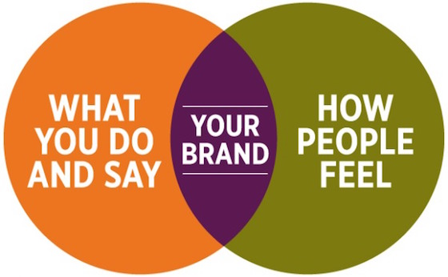
Brand equity
Brand equity is the added value endowed to products and services with consumers.
It may be reflected in the way consumers think, feel, and act with respect to the brand, as well as in the prices, market share, and profitability it commands.
The study of brand equity is concerned with how and what makes brands more valuable, stronger and receptive to the consumers in the
market place.
2/5/2019 10:03 PM

Slide 83
Brand equity
Chernatony and McDonald
Brand equity consists of differential attributes underpinning a brand which gives increased value to the firm’s product or service.
David Aakar
Brand equity is a set of brand assets and liabilities linked to a brand, its name and symbol add to or subtract from the value provided by a product or services to a firm and/or to that firm’s customers.
Kevin Keller
Brand equity is defined in terms of marketing effects uniquely attributable to the brands-for example, when certain outcomes result from the marketing of a product or service because of its brand name that would not occur if the same product or service did not have the name.
2/5/2019 10:03 PM

Slide 84
Brand value to the customer
It is the brand equity that makes brand strong and provides a plenty of advantages to them. A good or strong brand provides following value or advantages to the customers:
-Good or strong brands are the package of information and helps customers in information processing i.e. interpreting, processing and storing information about products and brands.
-Good or strong brands enhance customer’s confidence in the purchase decision by removing confusion regarding product selection; because they perceive a strong or good brand as the symbol of quality.
-Good or strong brands provide customers usage satisfaction, which the unbranded or unpopular brands cannot provide it to customers; because strong brands or a good brand assures customers for product performance.
2/5/2019 10:03 PM

Slide 85
Brand value to the marketers
A good or strong brand provides the following values or advantages to the marketers:
- It is an asset that yields adequate revenue to the company for a longer period.
- It makes a firm’s marketing programs more effective and efficient.
- It allows a firm to have greater customer loyalty.
- It allows a firm to charge premium price to its products because customers become ready to pay high price for good brand or strong brand.
- It provides greater opportunities for growth to the firm within a limited time period.
- It provides competitive advantage to the firm.
- It adds promotional value to the firm and makes marketing communication more effective.
- It is a good source of achieving leverage (ability to influence) in distribution channels, because trade partners give priority in distributing strong brands that others.
- It allows additional brand extension opportunities.
2/5/2019 10:03 PM

Slide 86
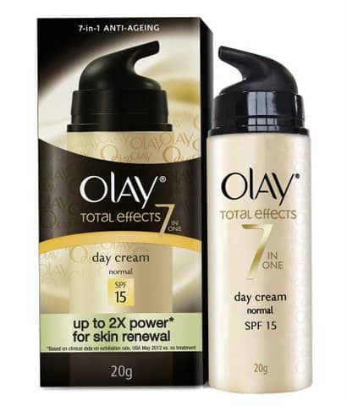
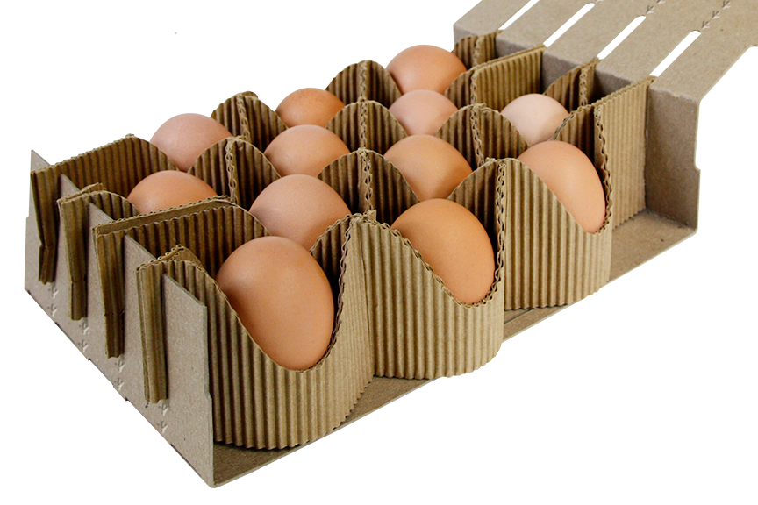
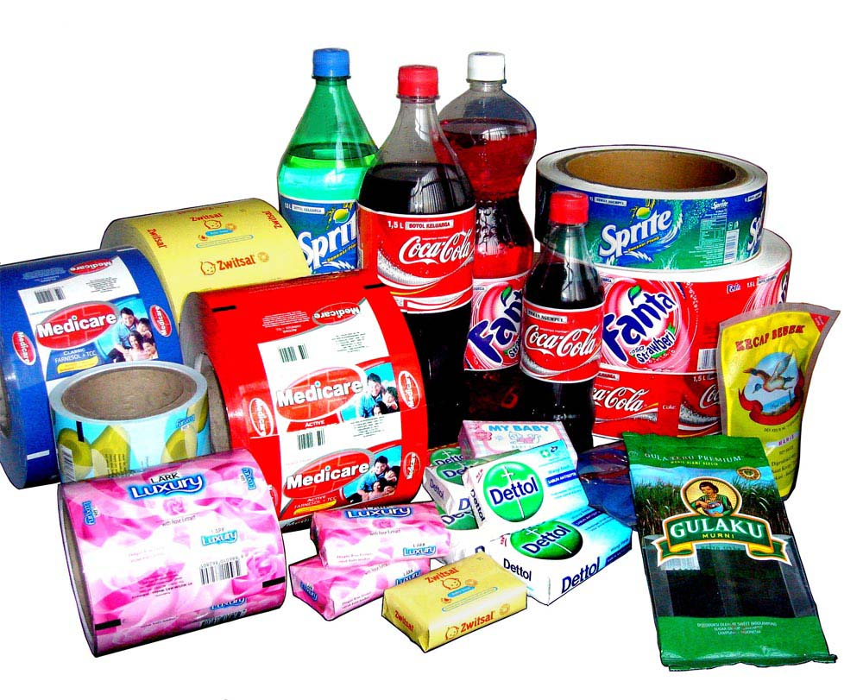
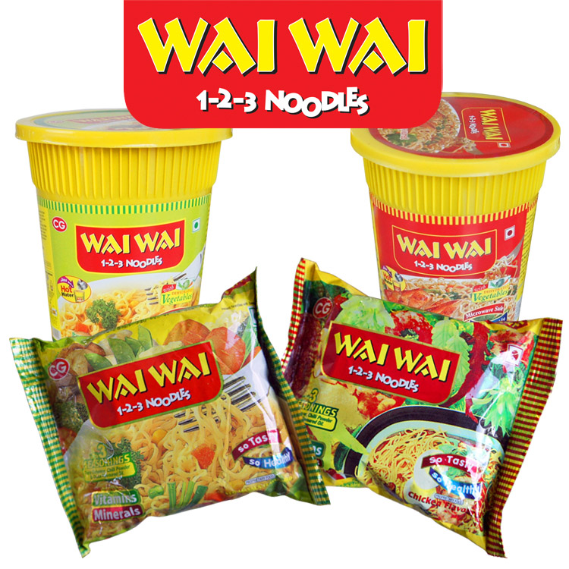
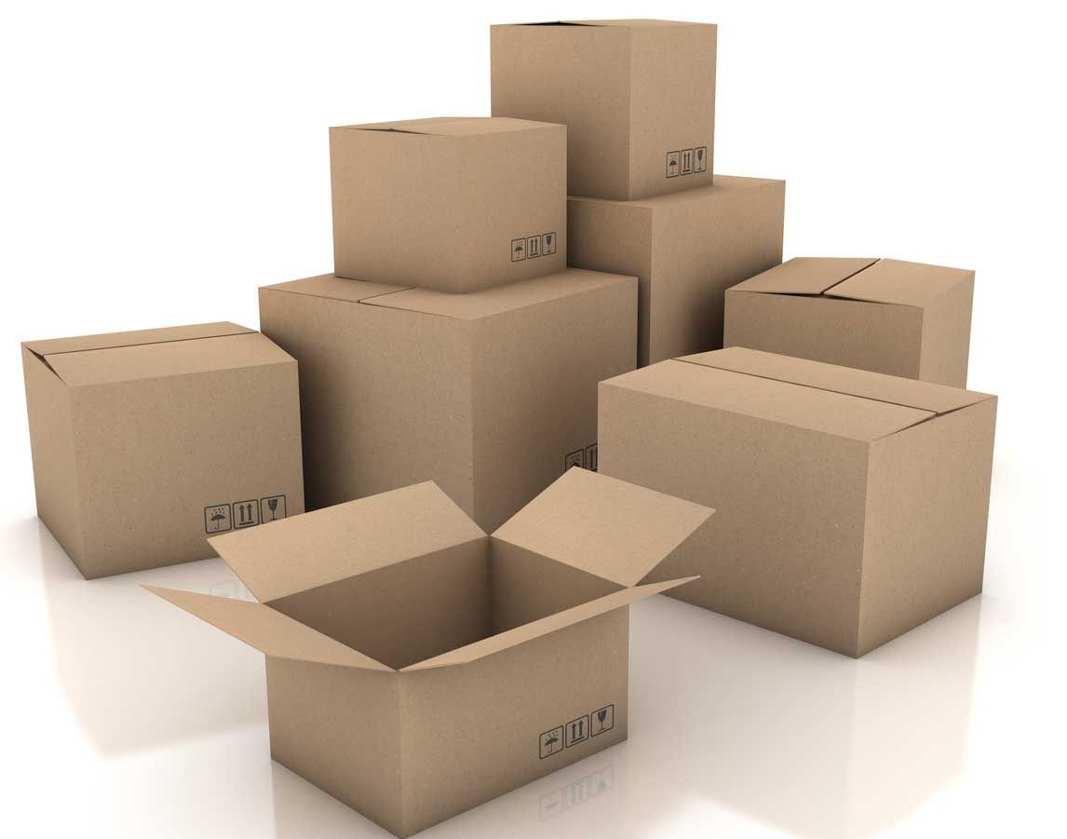
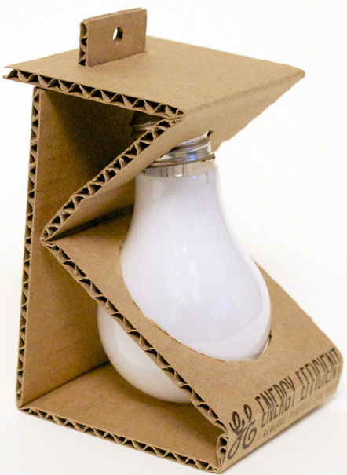






packaging
2/5/2019 10:03 PM

Slide 87

packaging
A package means wrapper or cover or container in which a product is enclosed. It is an act of designing or producing the package for a product.
Marketers of goods often refer packaging as the fifth “P” of marketing.
It provides information to buyers about the product, its attributes and methods of use.
It can make the product more versatile, safe and easier to use.
Philip Kotler
“Packaging includes the activities of designing and producing the container or wrapper for the product.”
2/5/2019 10:03 PM

Slide 88
Functions/Objectives of packaging
Containment\
Storage
Identification
Protection
Communication
Product Differentiation
Promotion
2/5/2019 10:03 PM

Slide 89



Levels of packaging
Materials used for packaging: Glass, Wood, Tin, Aluminium Foil, Plastics, Paper, Cloths etc.
Packaging
Primary Package
Secondary Package
Shipping Package
2/5/2019 10:03 PM

Slide 90
Packaging types
1. Unit Packaging:
One product item is placed in one package. E.g. One candy bar.
2. Family Packaging:
Multiple items of one product are placed in one package which is also called economy package. E.g. Three candy bars in one pack.
3. Line Packaging:
Identical packaging is used for all items in a product line. E.g. Identical packaging for all items of Real Juice of Dabar.
4. Banded Packaging:
Several related product items are packed in one package. E.g. Shampoo, soap and hair oil in one package.
5. Multiple Packaging:
Separate packages are used according to size and weight of the product. E.g. Packs of 500grams and 1kg.
2/5/2019 10:03 PM

Slide 91
Essentials of good package
Economical
Functional
Communicative
Attractive
Eco-friendly
2/5/2019 10:03 PM

Slide 92

Product line & mix strategies
What is product line? & What is product mix?
2/5/2019 10:03 PM

Slide 93

Product line & mix strategies
2/5/2019 10:03 PM

Slide 94
Product line & mix strategies
What is product line?
Product line is a group of closely related products.
They perform similar function and fulfill the identical needs and wants of the customers.
They are sold to the same customer groups.
They are marketed through the same channels.
They fall within given price range.
William J. Stanton
A broad group of product, intended for essentially similar uses and possessing reasonably similar physical characteristics, constitutes a product line.
Cravens, Hills and Woodruff
Product line is a group of products that are in some way related by being alternative to fulfilling the same customer need by being marketed to the same target markets or through the same distribution network, or by being in a common price category.
2/5/2019 10:03 PM

Slide 95
Product line & mix strategies
Product Line Strategies
Product Line Analysis
Product line strategies require analysis of total sales and profits contributed by each item in the line.
Product Line Strategies
Product Line Length
Product Line Modernization
Line Featuring
2/5/2019 10:03 PM

Slide 96
Product line & mix strategies
Product Line Strategies
Product Line Length
Product Line Modernization
Line Featuring
It includes total interrelated items in a product line that the company deals in. Organizations seeking high market share carry longer lines. Those seeking profitability carry shorter lines. Product lines tend to lengthen over time. Product line length decisions involve line expansion and line contraction.
Line Expansion:
Line Stretching
Trending Up - Add higher price items to the line to enhance image.
Trending Down - Add lower price items to the line to block competitor.
Line Filling- Add more items within the current market price.
Line Contraction
Product line is reduced by dropping items. Money losing items are normally dropped. Items with poor sales are also dropped.
2/5/2019 10:03 PM

Slide 97

Product line & mix strategies
Product Line Strategies
Product Line Length
Product Line Modernization
Line Featuring
Organization continuously modernize their product lines to cope with changing technology, increasing competition and changing customer preferences.
Product improvements are planned to encourage customer migration to higher priced items.
Then
Now
2/5/2019 10:03 PM

Slide 98



Product line & mix strategies
Product Line Strategies
Product Line Length
Product Line Modernization
Line Featuring
It involves featuring one or two low-priced or high-priced items to attract a specific group of customers. Low-priced items attract price-sensitive customers. High priced items provide prestige to the product line.
2/5/2019 10:03 PM

Slide 99

Product line & mix strategies
Product Mix Strategies
Philip Kotler
Product mix is the set of all product lines and items that a particular seller offers for sale.
Product’s Width
Product Depth
Product Length
Product Consistency
2/5/2019 10:03 PM

Slide 100
Product line & mix strategies
Product Mix Strategies
Product’s Width
It refers to the number of product lines. Product width can be modified by adding or deleting a product line.
Product Depth
It refers to the number of product items in a product line. Product depth can be modified by adding or deleting product items in a product line.
Product Length
It refers to total number of product items in the product mix. It ca be modified by adding or deleting product items. General Electric Company has about 250,000 items in the product mix.
Product Consistency
It refers to how closely related the various product lines are. Consistency can be increased by adding closely related product lines. It can be decreased by adding unrelated product lines.
2/5/2019 10:03 PM

Slide 101
Service product
American Marketing Association:
Activities, benefits or satisfactions which are offered for sale, or are provided in connection with the sale of goods.
Philip Kotler:
A service is any act or performance that one party can offer to another that is essentially intangible and does not result in the ownership of anything. Its production may or may not be tied to a physical product.
William J. Stanton:
Service is an identifiable, intangible activity that is the main object of transaction designed to provide want satisfaction to customers.
2/5/2019 10:03 PM

Slide 102
Service product
In modern marketing, only the physical goods are not termed as products.
It also covers the service in terms of product.
Services are not easy to define or classify.
The essential characteristic of services is their intangibility.
A service is an act or benefit that does not result in the customer owning anything. It is experienced, not consumed.
It may be any activity, benefit or satisfaction which is offered for sale.
Airlines
Banks
Insurance
Telephone
Credit Card
Hotel
Repair
Beauty Shops
Advertising Agencies
Lawyers
School Colleges
Hospital
Television
Radio
Guarantees
Installation
Tips
2/5/2019 10:03 PM

Slide 103
Service product–characteristics/nature
Intangibility
They cannot be seen, tasted, touched or smelled before they are bought.
It has difficulty in evaluating a service before purchase.
The customer cannot own a service but payment is made for use or performance.
Inseparability
Services are normally produced and consumed at the same time and at the same place.
e.g. Medical examination.
Variability
Services are highly variable and depends on who provides them and when and where they are provided. Standardized output is not possible.
Perishability
The services cannot be saved or consumed and cannot be stored for the future.
2/5/2019 10:03 PM

Slide 104

Service product– types
People based or equipment based
Personal or business
For profit or not for profit
Client presence or absence
2/5/2019 10:49 PM

Slide 105


Service product– types
Porter, mechanic, doctor
People Based
Or
Equipment Based
Vending machines, computers
2/5/2019 10:56 PM

Slide 106



Service product– types
Hair cutting, entertainment
Personal
Or
Business
Marketing research, insurance, audit
2/5/2019 11:10 PM

Slide 107


Service product– types
Private nursing home, banks, private colleges
For Profit
Or
Not for Profit
Government hospitals, churches
2/5/2019 11:20 PM

Slide 108


Service product– types
Students for teaching
Client Presence
Or
Absence
Shoe repair
2/5/2019 11:27 PM

Slide 109
Service marketing strategies – 7p’s
Product
People
Pricing
Physical Evidence
Place
Process
Promotion
2/5/2019 10:03 PM

Slide 110
Service marketing strategies – 7p’s
Product
Launch limited line or broad line services.
Service line length expansion or contraction.
Service line modernization through service improvements.
Service line featuring by focusing high-price or low-price service.
Service mix consistency by providing closely related services lines.
Creating favorable brand image.
Quality management through consistency in providing service.
Managing product support services. Pre-sales, during-sales and post-sales.
2/5/2019 11:34 PM

Slide 111
Service marketing strategies – 7p’s
Price
One price strategy.
Flexible pricing strategy. Discounts are common in services marketing. E.g. A season ticket for bus, discount for timely payment of bank interest.
Competition based pricing.
Place/Distribution
Provide good locations which are convenient to consumers.
Short channels are used because of inseparability of services. Agent middlemen are used (insurance agents, share brokers.)
2/5/2019 11:34 PM

Slide 112
Service marketing strategies – 7p’s
Promotion
Personal selling is given a dominant role.
Advertising is extensively used by non-profit organizations; professional associations prohibit advertising in legal, accounting and medical fields. Word of mouth is important for promotion.
Sales promotion is frequently used. Many banks provide insurance coverage to saving account holders.
Publicity and public relations are very important.
People
Interactive marketing (service quality)- Employee skills in serving the client.
Internal marketing- It is investment in human resources to train and motivate employees to better serve the customers.
2/5/2019 11:34 PM

Slide 113
Service product–characteristics/nature
Physical Evidence
It is demonstration of service quality through physical evidence.
In case of physical evidence mix strategies, a service organization can make the following decisions:
Entrance and exit, comfortable surroundings, superior décor, reception counter, furnishing etc.
Hotels have elaborate decorations and beautiful gardens. Dentists have comfortable waiting rooms. Airlines have uniquely dressed air hostesses.
Process
Process refers to the procedures, mechanisms and flow of activities by which a service is acquired. It affects how a service is delivered to customers. In case of process mix strategies, a service organization can make the decisions on: advances in technology(e.g. automated queue), delivery process, channel design, people providing service…
2/5/2019 10:03 PM

Slide 114
case
Deepshikha Malla teaches computer at a private business college. She has a M.E. degree in computer engineering from the Asian Institute of Technology. Shanti Shakya is her friend. She is working as a computer technician at Nepal Telecommunications Corporation. Both of them feel frustrated in their jobs. They decided to start computer business called “Quick Solutions Computer Company”.
Shanti left her job and has been working full-time. Deepshika devotes 20 hours a week in the business. They provide high quality products and services consisting of:
Computerized accounting software programme for banks.
Computer programmes as per client needs.
Computer training.
Computer consulting.
Service of hardware.
The business has been in operation of three years. Sales are increasing and orders are coming in steadily. The accounting software programmme developed by them has been popular with the banks. The competition has been stiff for computer training. Word processing business is poor.
Deepshikha and Shanti think that adjustments are needed in their product mix. They also feel that some new products should be added.
They have asked your help to find answers to the following questions:
What is the product mix of the company?
What adjustments should be made in the product mix?
Should the company brand its products?
What new products can be offered by the company?
2/5/2019 10:03 PM

